Slide 1

Social Media Data Analysis
This presentation explores the analysis of social media data, focusing on sentiment classification and data visualization using the Sentiment140 dataset.
Presented By:
Ayesha Jadoon - 14638

Slide 2
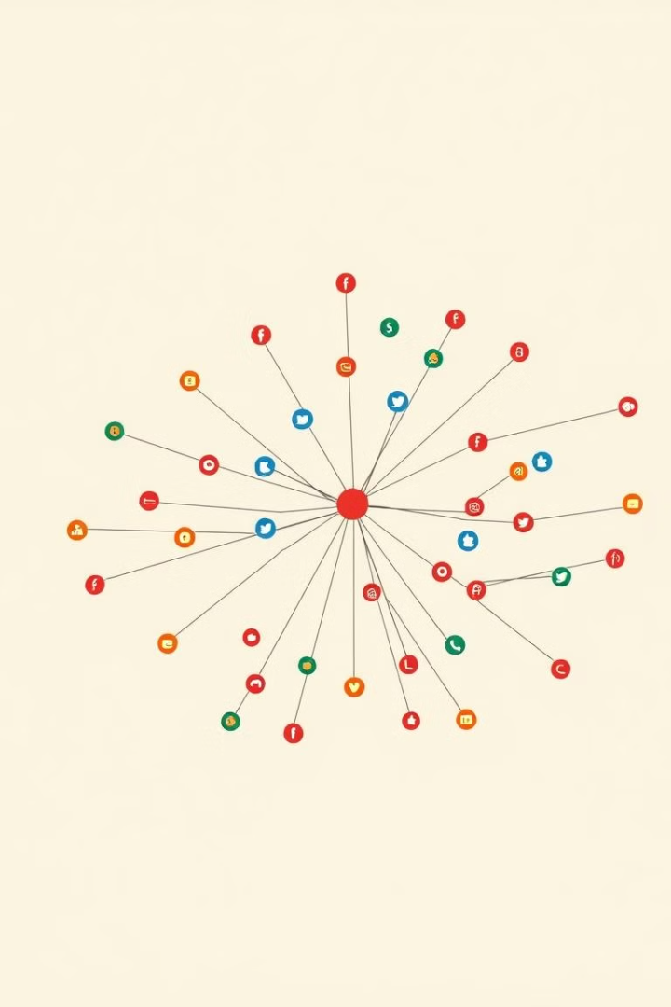
Introduction
Purpose
Objectives
This project aims to analyze social media posts to classify sentiment (positive, negative, neutral) using the Sentiment140 dataset.
Create visualizations to display sentiment distribution, frequent words, and a word cloud to identify trends and patterns in the data.

Slide 3
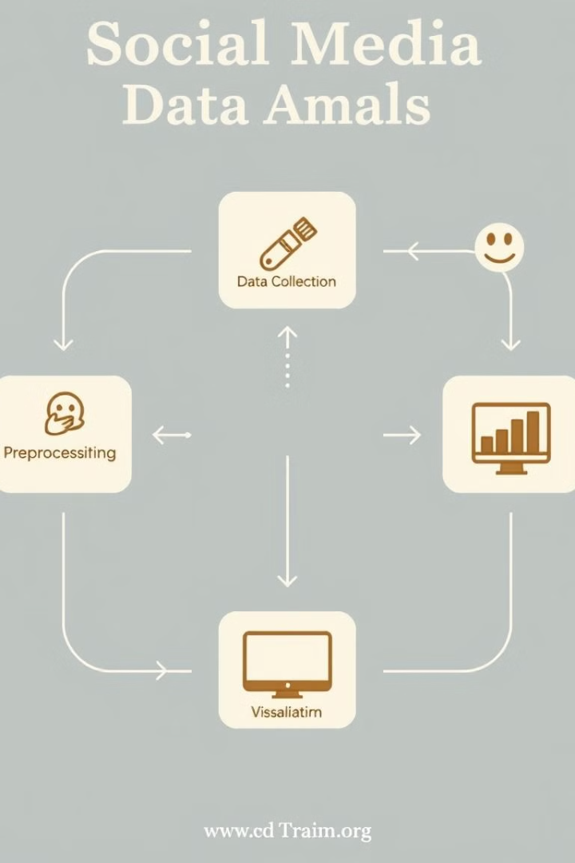
Project Scope
1
Preprocess Data
2
Classify Sentiment
Clean text and remove noise.
Identify Positive, Negative, or Neutral sentiment.
3
Visualize
Create word clouds and sentiment charts.

Slide 4
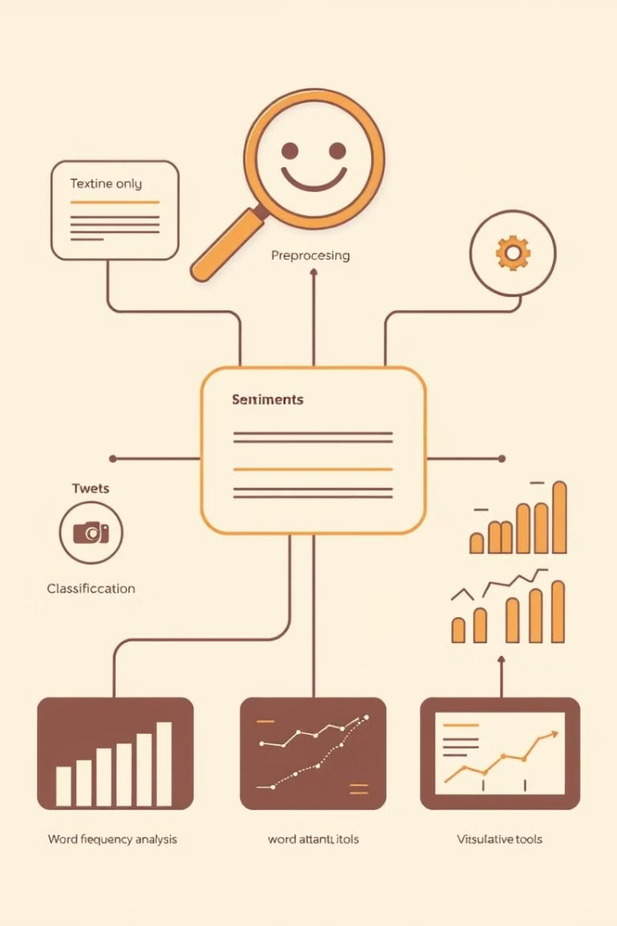
Features
Text Preprocessing
Sentiment Classification
Cleaning and preparing text data using techniques like stemming and removing stopwords.
Classifying social media posts as Positive, Negative, or Neutral using TextBlob for sentiment polarity.
Word Frequency Analysis
Sorting by Sentiment
Sorting tweets by their sentiment classification for better analysis.
Analyzing word frequencies to identify common terms in posts.

Slide 5

DSA in the Project
1
Data Structures:
Hashmaps: Used to store and efficiently retrieve sentiment classifications for tweets.
Lists & Dictionaries: Managed data like word frequencies and sentiment labels.
2
Algorithms:
Text Preprocessing: Algorithms like stemming and stopword removal to clean the text data.
Sorting: Implemented sorting algorithms to organize tweets by sentiment classification for analysis.
Sentiment Classification: Logistic Regression algorithm used for sentiment analysis of tweets.

Slide 6

Data and Results
Input
Output
CSV file with social media posts (e.g., tweets, reviews).
Processed CSV file with processed_text: Cleaned text, and sentiment: Classified sentiment (Positive, Negative, Neutral).

Slide 7

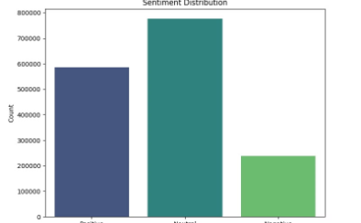
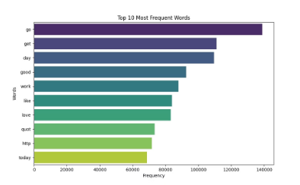
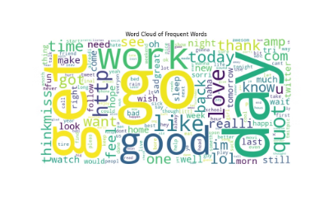
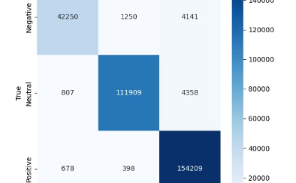
Visualizations
Sentiment Distribution (Bar Chart)
Top Words (Bar Chart)
Word Cloud
Confusion Matrix
Shows the top 10 most frequent words.
Displays the most frequent words in the data.
Visualizes how well the model predicts each sentiment (Positive, Negative, Neutral).
Displays the count of each sentiment type (Positive, Negative, Neutral).

Slide 8





Machine Learning Model
Data Preparation
1
Cleaned and prepared text using DSA concepts like preprocessing (stemming, stopwords removal) and data structures (hashmaps, lists).
Model Training
2
Applied Logistic Regression for sentiment analysis, supported by efficient data handling.
Model Evaluation
3
Used sorting and metrics (accuracy, precision, recall) to evaluate model performance.
Deployment
4
Deployed the trained model to predict sentiment in new posts, benefiting from DSA optimizations.

Slide 9

Conclusion
Project Achievement
Key Findings
Efficiently processed and analyzed social media data to classify sentiments and extract valuable insights.
Positive, Negative, and Neutral sentiments were successfully identified. Word frequency analysis revealed the most discussed topics.

Slide 10

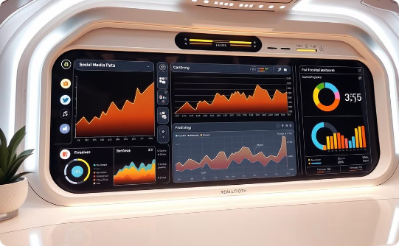
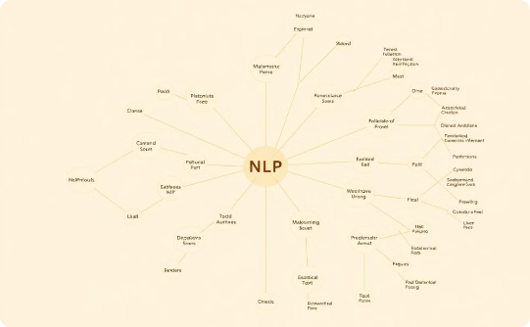
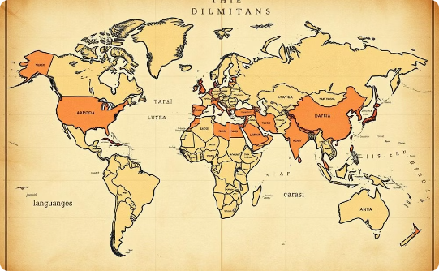
Future Work
Real-time Data
Advanced Models
Multilingual Analysis
Modify the system to access real-time data from social media APIs for continuous sentiment analysis.
Explore advanced NLP models for more accurate sentiment classification.
Enhance the system to process and classify sentiments in multiple languages.

Slide 11

Thank You!

